Slide 1

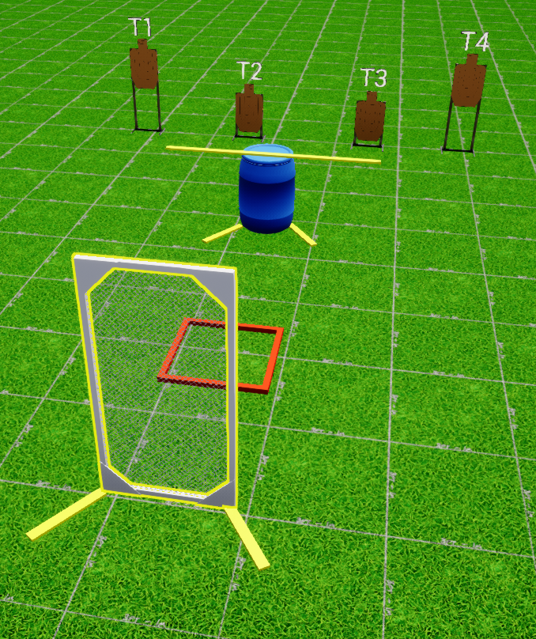
 | Interlake Sporting Association North Pistol, A Stage: High or Low Course Designer: Peter Jarvis
START POSITION: Standing in start box. Handgun loaded and holstered, wrists below belt. PCC loaded with safety on, stock on belt muzzle pointed downrange. |  | STRINGS: 1 SCORING: Unlimited/Limited ROUND COUNT: 4 START-STOP: Audible - Last shot Muzzle Safe Points: 180 degree rule SO Notes: Procedural for each shot fired above bar at P2
STAGE PROCEDURE: At the start signal, engage T1 from the left of P1, T4 from the right side of P1, and T2 from the left side of P2 and T3 from the right side of T3. Shots fired at P2 must be under the bar. Reload required between first and last shot
P2
start
P1

